Slide 1
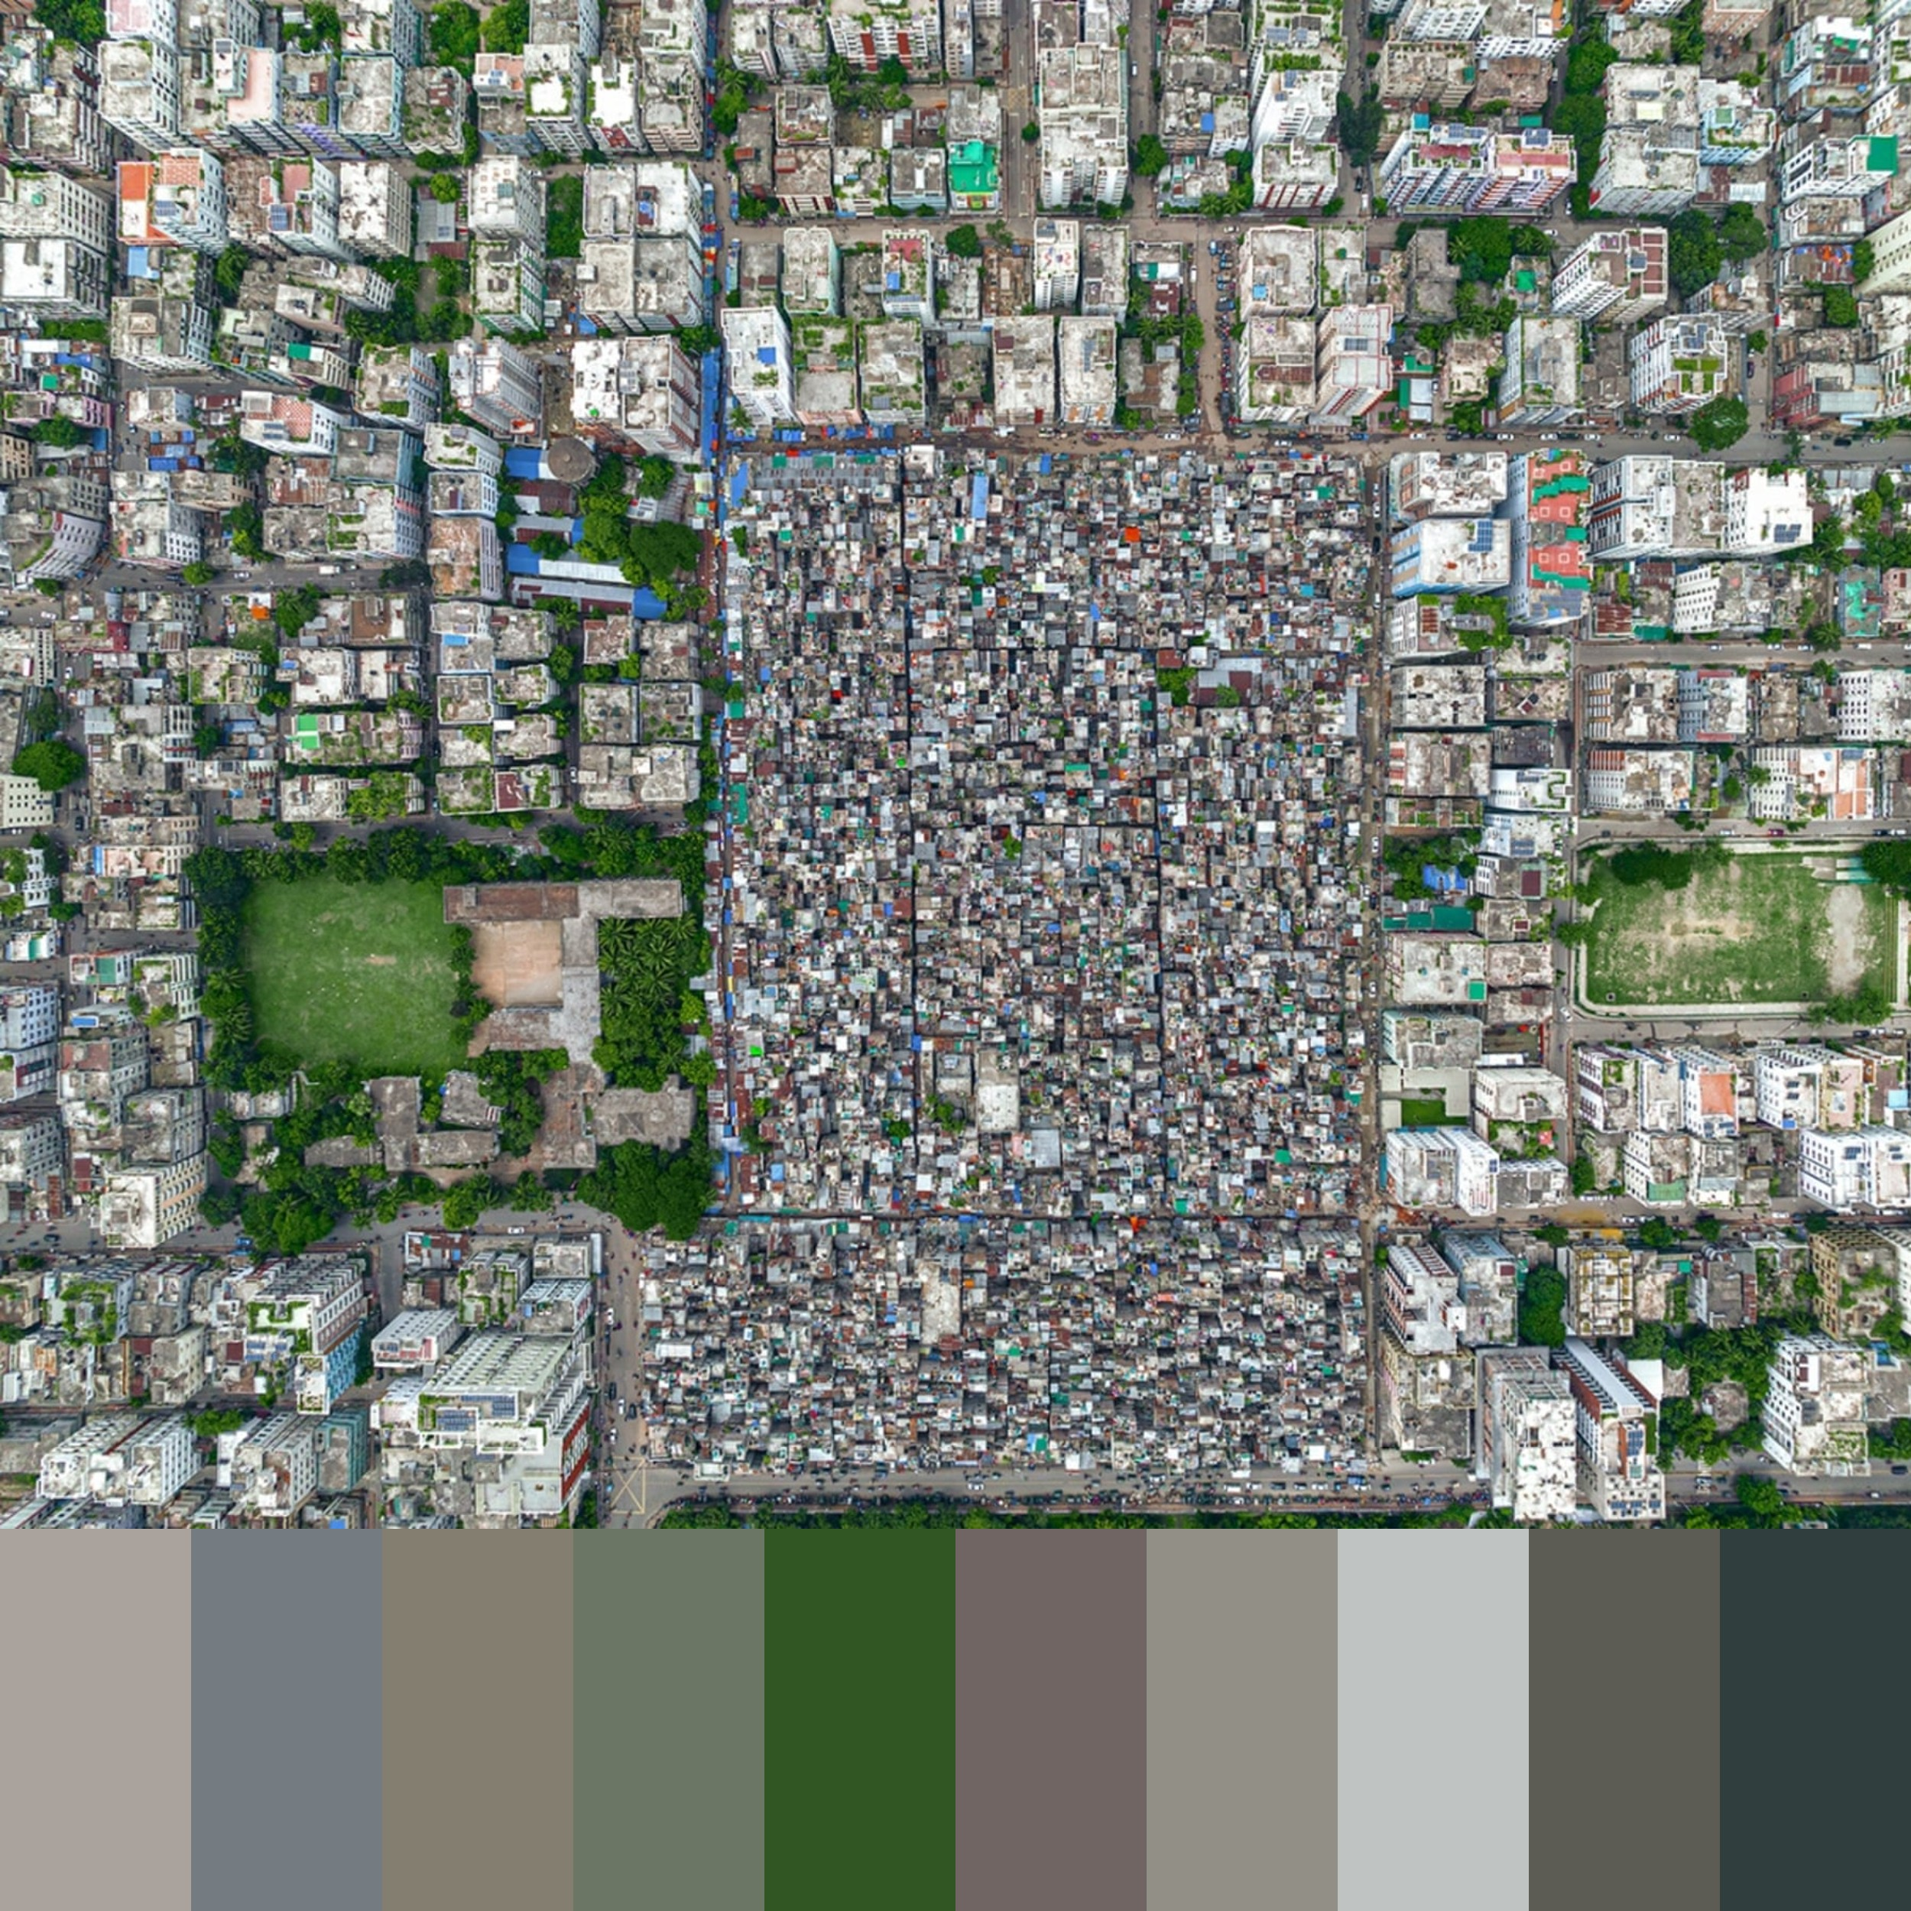
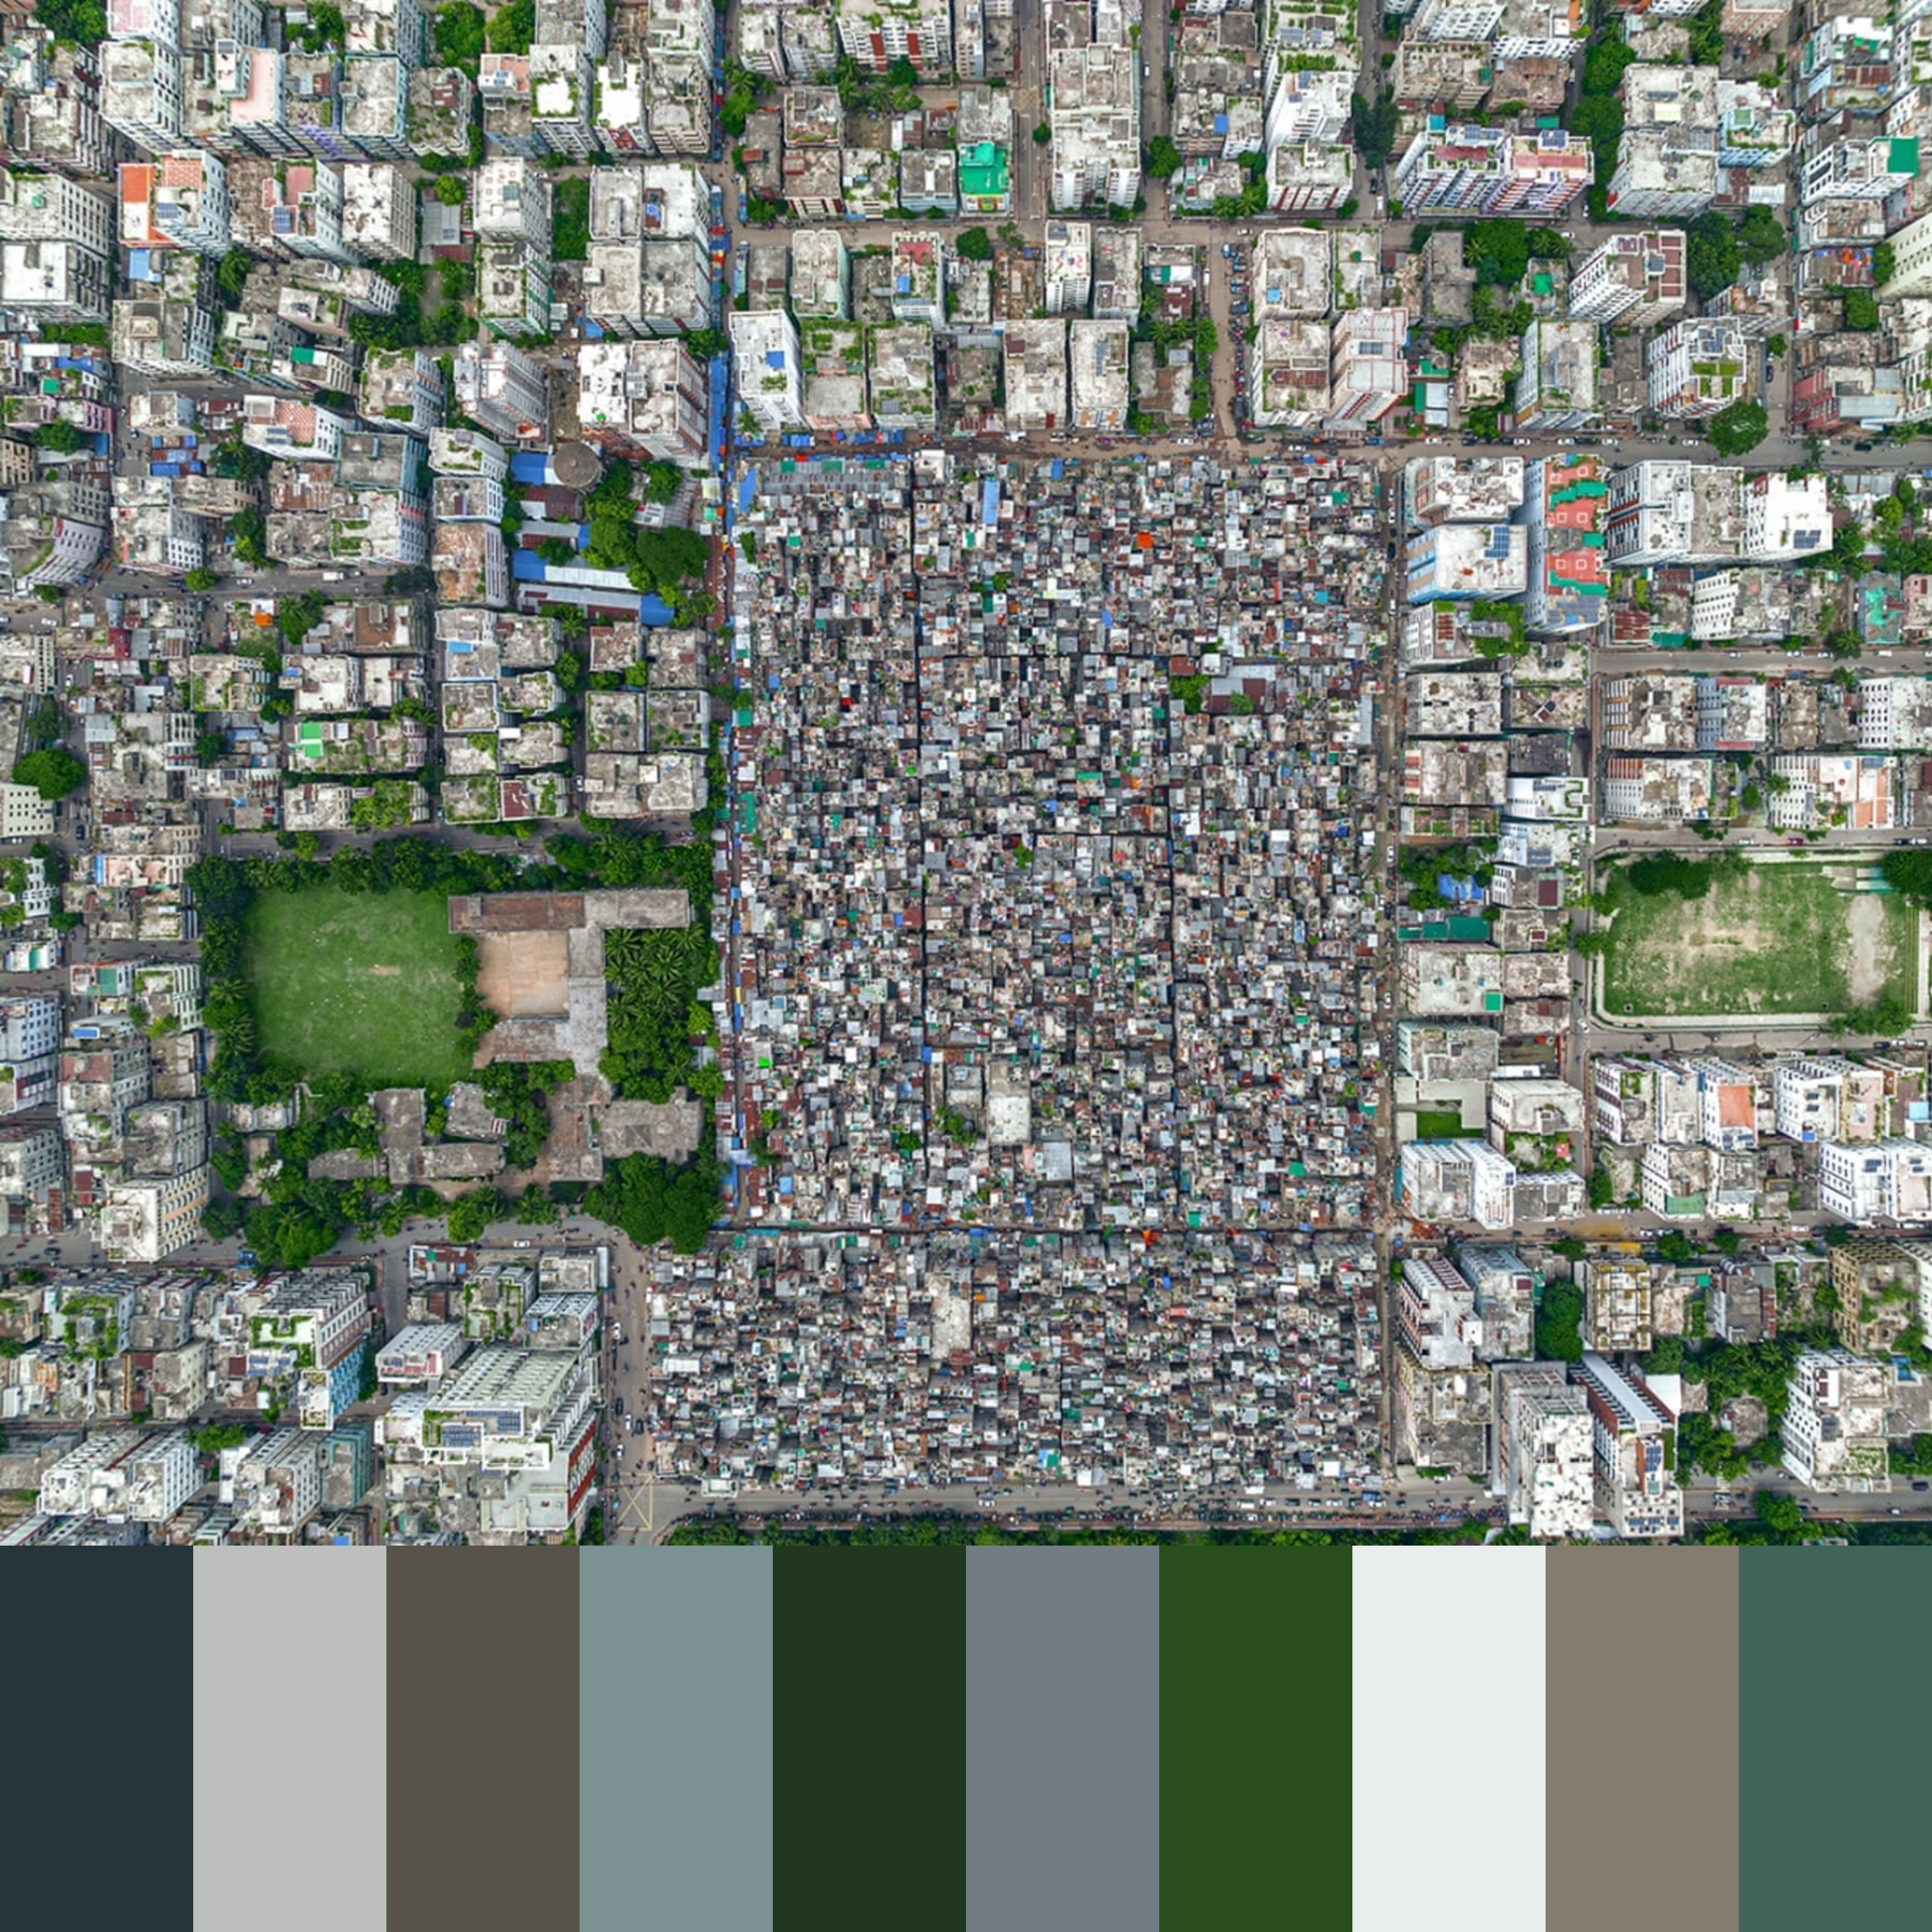
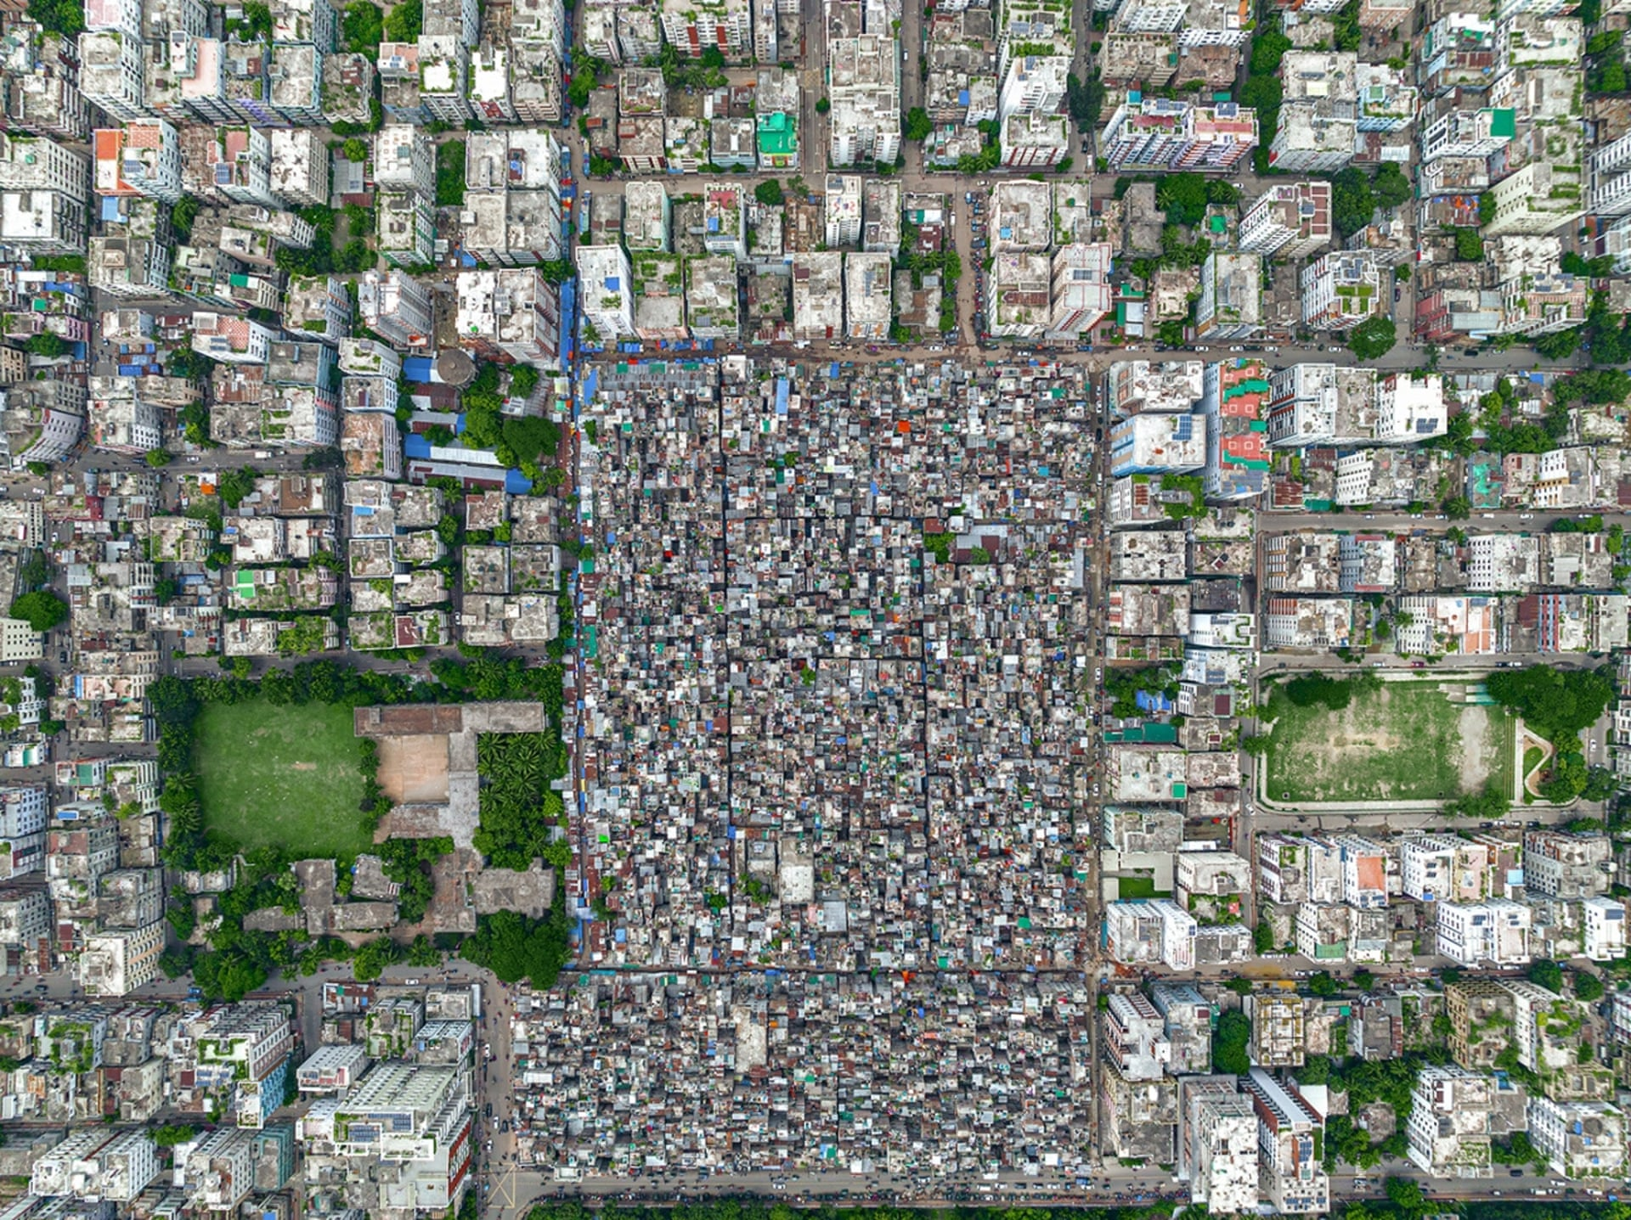
Smart Housing Allocation App for Slum Reduction in Dhaka
A Data-Driven Solution for Sustainable Urban Development
Professional Environments 1
Group A18
Abdul Hadi
Gursimran Thumber
Hemanth Jonnalagada
Marco Pereira da Silva
Yousef Al-Mansoor

Slide 2
The Growing Slum Population Crisis in the City of Dhaka
RURAL TO URBAN MIGRATION
> Since Bangladesh’s independence in 1971, millions
of people have moved from rural areas to Dhaka
in search of better living conditions
> Frequent floods, river erosion and
declining agricultural opportunities in
rural areas have forced people to
migrate
POLITICAL
AND SOCIAL ISSUES
> Landlords and local political
actors often profit from slum
settlements, preventing efforts to
relocate or improve conditions
> Many slums lack proper legal recognition,
making it difficult for residents to access basic
services like water, sanitation and
healthcare
ECONOMIC FACTORS
> Dhaka’s booming garment industry
and informal sector jobs attract low-skilled
workers who settle in slums due to lack of
affordable housing
> Economic disparity means that while some
parts of Dhaka develop rapidly, a
significant portion of the
population remains in
poverty
LAND
SHORTAGE AND
HIGH PROPERTY PRICES
> Dhaka is one of the most densely
populated cities in the world, leading to a
housing crisis
> The high cost of formal housing forces
low-income migrants to live in informal
settlements
INADEQUATE URBAN
PLANNING AND GOVERNANCE
> Dhaka’s infrastructure has not kept pace
with its population growth
> A lack of affordable housing policies and
weak enforcement of land regulations
have allowed slums to expand
CURRENT CHALLENGES
Poor Living Conditions: Overcrowding,
lack of sanitation and unsafe housing
Health Risks: Waterborne diseases, malnutrition and inadequate healthcare
Vulnerability to Eviction: Many slum dwellers live under the constant threat of eviction by authorities

Slide 3
Possible Solutions
1
2
3
4
5
Government Intervention and Policy Reforms
> Affordable Housing
Projects
> Slum Regularization
and Land Rights
> Urban Planning and
Decentralization
Infrastructure Development and Basic Services
> Water Distribution
and Sanitation
Facilities
> Public Transport and
Connectivity
> Resilient Housing
Private Sector Involvement
> Microfinance for
Slum Dwellers
> Public-Private
Partnerships for
Affordable Housing
Solutions
Social and Community Programs
> Education and Skill
Development
> Healthcare Access
> Community-Based
Development
Preventing Future Slum Growth
> Job Creation in
Rural Areas
> Sustainable Urban
Expansion

Slide 4



How We Solve the Problem
How It Works
> Data Collection and Analysis: The app gathers data from satellite imagery, government records, mobile network activity and crowdsourced user reports
> AI-Driven Recommendations: AI algorithms process the data to identify underutilised areas suitable for development
> Relocation Assistance: The app suggests affordable housing options near workplaces and social services to help slum dwellers relocate
> Government and Developer Dashboard: Provides real-time insights for policymakers, investors and developers on where to build new housing
> User Interface: A simple mobile and web-based platform where users can check housing options and government aid programs
Our Solution
A Smart Housing Allocation Application that utilizes real-time data analysis and AI-driven insights to optimize urban planning in Dhaka.
The app will analyse population distribution, housing costs, land availability, and proximity to essential services (healthcare, education, transport, and workplaces) to recommend the best locations for new affordable housing projects and relocation programs.
B
A
C
Target Public
> Government Authorities: Helps with urban planning and housing policies
> Developers: Identifies strategic locations for cost-effective housing constructions
> Population: Finds housing options that fit their budget and are close to workplaces and social services

Slide 5


Competitors Analysis
1
2
3
Government Projects
Strengths
> Large-scale projects backed by government funding
> Aimed at providing affordable housing for low-income populations
> Official urban development policies support expansion
Weaknesses
> Bureaucratic inefficiencies slow down implementation
> Poor data-driven decision-making leads to misallocation of resources
> Limited integration with job opportunities and social services
> High construction and administrative costs
NGO Initiatives
Strengths
> Strong focus on social impact and low-income community welfare
> Provides direct aid to people in need
> Works closely with local communities for sustainable solutions
Weaknesses
> Limited funding and dependence on donation slow down large-scale expansion
> Small-scale projects that lack technological integration
> Minimal use of big data and AI for housing allocation
> Not scalable to accommodate rapid urban growth
Private Developers
Strengths
> Large-scale construction and investment capabilities
> Can build high-quality housing and urban infrastructure
> Profitable and sustainable business model
Weaknesses
> Focused primarily on high-income and commercial projects
> Unaffordable for slum dwellers and low-income groups
> Lacks consideration for proximity to essential services
> Does not address overpopulation and urban poverty issues
Feature | Government Projects | NGO Initiatives | Private Developers | Our Solution
Data-Driven Approach
AI and Real-Time Insights
Affordable Housing Focus
Scalability and Adaptability
Integration with Jobs / Services

Slide 6





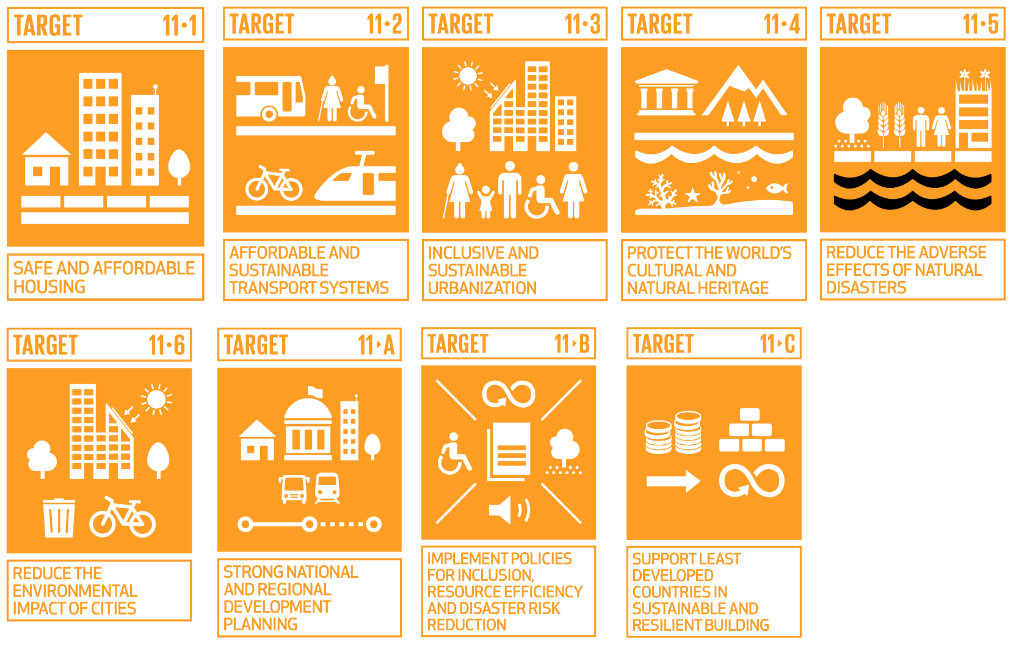

Our Unique Selling Point
Adaptable
Scalable and adaptable, this application can be applied to other cities facing similar urban challenges
Resource Allocation
Better resource allocation enables governments and developers to build housing in optimal locations with minimal congestion
Data-Driven and AI
Data-driven decision making and AI powered analysis in real-time of population and infrastructure ensures better planning
Focused
The application focuses on multiple SDG11 goals, important to the overall success of a city.
Relocation Assistant
Relocation assistance helps slum dwellers find affordable housing closer to workplaces and social services
Guides
Affordability and accessibility guides, steer developers to low-cost land options, reducing overall housing prices

Slide 7


Value Proposition Canvas
Population
> Neighbourhood growth projections
> Confidence in future infrastructure and service improvements
> Access to urban development plans
Government
> Real-time dashboards showing slum reduction progress
> Success metrics to share with the public and global organizations
> Tools to apply for international housing funding
Developers
> Priority access to high-opportunity land areas
> Early insights into upcoming government tenders
> Custom reports for investment pitches
Government
> Data-driven, targeted slum reduction strategies.
> Successful, high-impact affordable housing projects
> Increased public trust through transparency
> Increased global reputation for urban development
Developers
> Identifying high-demand housing zones
> Faster project approvals with aligned government data
> Reduced risk through understanding slum dynamics and growth areas
Population
> Safer, more stable neighbourhoods
> Rising property values through organised development
> Insight on where to buy or sell property
Government
> Identify areas with high slum population
> Plan and prioritize affordable housing projects
> Reduce slum population with urban planning
> Allocate budgets efficiently
> Ensure social stability and avoid unrest
Report development progress and impact
Governments
Slum Population Heatmaps – Visual representation of areas with high slum population using real-time and historical data
Gain Creators
Gains
Products and Services
Jobs
Developers
Land Suitability and Opportunity Maps – Identify viable plots for development based on slum data, government incentives and infrastructure
Population
> Identify high-growth, investment-friendly areas
> Ensure their neighbourhoods remain desirable
> Avoid proximity to unmanaged slum areas
> Influence local development policies
Pain Relievers
Pains
Population
Neighbourhood Stability Index – Rating for areas based on proximity to slums, development plans and future risk assessments
Government
> Difficulty locating and quantifying slum population
> High urbanization pressures with limited resources
> Public backlash over relocation or redevelopment
> Corruption risks in funds allocation
> Inefficient inter-departmental coordination
Government
> Automated slum detection and mapping
> Predictive models for future slum growth
> Budget and project tracking tools to prevent corruption
> Collaboration features to align multiple departments
> Social impact assessments to avoid public unrest
Developers
> Find profitable areas to build new housing
> Identify government supported affordable housing zones
> Assess land value and growth potential
> Ensure compliance with zoning and regulations
> Reduce project risks linked to social or legal issues
Developers
> Profitability analysis based on land and population data
> Risk identification for unstable regions
> Clear guidelines on government support projects
> Faster access to zoning and planning data
Developers
> Risk of investing in unstable areas
> Slow government approval processes
> Legal complications in land acquisition
> Unclear demand for affordable vs. luxury housing
Population
> Fear of declining property values due to nearby slum growth
> Lack of visibility into future neighbourhood changes
> Uncertainty about infrastructure strain from population growth
Population
> Area monitoring to predict neighbourhood changes
> Alerts about new housing developments
> Visual insights on improving infrastructure and services

Slide 8









Business Model Canvas
Business
Key Partners
Key Activities
Value Propositions
Customer Relations
Customer Segments
Our key partners, including government agencies, private developers, NGOs, and urban planners, will enable us to provide data-driven urban planning and optimized housing allocation, with the value of AI-driven insights for better housing solutions.
This will benefit governments by improving policy decisions, developers by identifying profitable investment areas, and slum dwellers by offering affordable relocation options.
Our cost structure, which includes AI infrastructure, data processing, software development, and stakeholder engagement, will be supported by revenue streams from government contracts, public-private partnerships, and international urban development grants.
This business model will enable us to sustain and scale our solution, ultimately reducing slum growth, improving urban planning, and ensuring accessible housing for low-income communities.
Governments
Developers
Non-governmental organisations
Social impact organisations
Technology partners
Academic and
research institutions
Platform development and maintenance
AI and data analytics
Collaboration with stakeholders
Public awareness events
Slum population heatmaps
to visually represent areas
with high slum population
using real-time and historical
data
Land suitability and opportunity maps to identify viable plots for development based on slum data, government incentives and infrastructure
Neighbourhood stability
index to rate areas based on proximity to slums,
development plans and
future risk assessments
Customer feedback, reviews and ratings
Community and customer support
Freemium model for
public users
Governments
Developers
Population
Key Resources
Channels
AI and big data infrastructure
Platform
Mainstream events
Platform
Social Media
Events overall
Cost Structure
Revenue Stream
Marketing
Platform Development and Maintenance
Events
Government contracts
Subscriptions and freemium model with paid features
Investors and Sponsorships

Slide 9
How We Will Fund Development
Funding
Our development will be funded through a combination of startup competitions, accelerator programs, and crowdfunding, alongside government contracts and public-private partnerships.
We will participate in startup competitions like "The Pitch" to gain initial funding and industry exposure.
Additionally, we plan to join the Geovation PropTech Accelerator, which provides financial support, mentorship, and networking opportunities to scale our solution effectively.
To engage public support and secure early-stage funding, we will launch a crowdfunding campaign on Kickstarter, allowing individuals and organizations to contribute to the development of our Smart Housing Allocation App.
These funding sources, combined with government contracts and partnerships with private developers, will sustain and expand our platform.
Funding Type | Best For | Funding Amount | Equity Required | Support and Mentorship | Competition Level | Main Benefit | Main Downside
Startup Competition: The Pitch | Early-stage startups needing credibility, funding and exposure | Up to £5,000 (Prize-based) | No equity required | Some mentorship (workshops and investor exposure) | Very high (many applicants, few winners) | Free funding and great exposure | Highly competitive, no guarantee of winning
Accelerator: Geovation PropTech Accelerator | Startups integrating tech with property and urban planning | Up to £20,000 + resources | Yes (equity-based, usually 5-10%) | High (mentorship, networking and workspace) | High (selective entry) | Expert guidance, funding and investor connections | Requires equity and time commitment
Crowdfunding: Kickstarter | Startups with mass appeal and strong storytelling | Varies (can be low to very high based on campaign success) | No equity required (rewards-based model) | Limited (customer driven validation) | Medium (Success depends on marketing and engagement) | No equity loss and builds an early customer base | Requires strong marketing, no guarantee of success

Slide 10

Conclusion
Forecast in a 5 to 10 years period
Slum Population Reduction
Living Conditions Improvement
Traffic and Urban Planning Efficiency
Economic Growth and Job Creation
Funding
Over the next 5 to 10 years, our Smart Housing Allocation App will play a crucial role in transforming urban development in Dhaka and beyond. By leveraging AI-driven insights and real-time data, we anticipate a significant reduction in slum populations, improved access to affordable housing, and more efficient resource allocation for governments and developers.
With continued government integration, private sector investments, and international funding, our platform will expand to other cities facing similar urban challenges, driving sustainable urban growth and better living conditions for millions. This innovation marks a crucial step toward smarter, data-driven urban planning and long-term housing solutions.

